Slide 1

The Spike-and-Slab RBM and Extensions to Discrete and Sparse Data Distributions
Aaron Courville, Guillaume Desjardins, James Bergstra, and Yoshua Bengio
IEEE TRANSACTIONS ON PATTERN ANALYSIS AND MACHINE INTELLIGENCE, VOL. 36, NO. 9, SEPTEMBER 2014
Presented by Robert McCartney and Jie Yuan

Slide 2
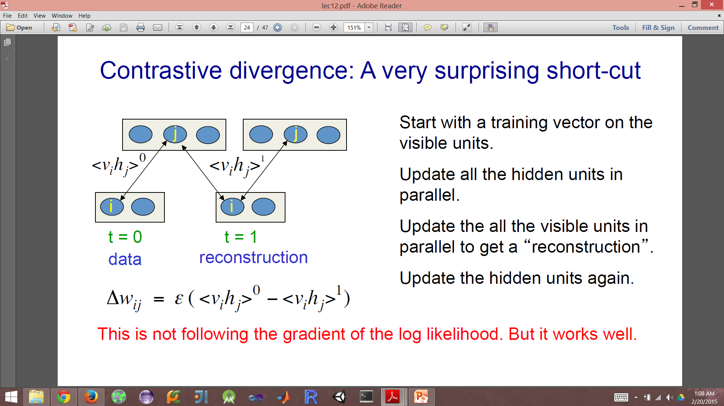
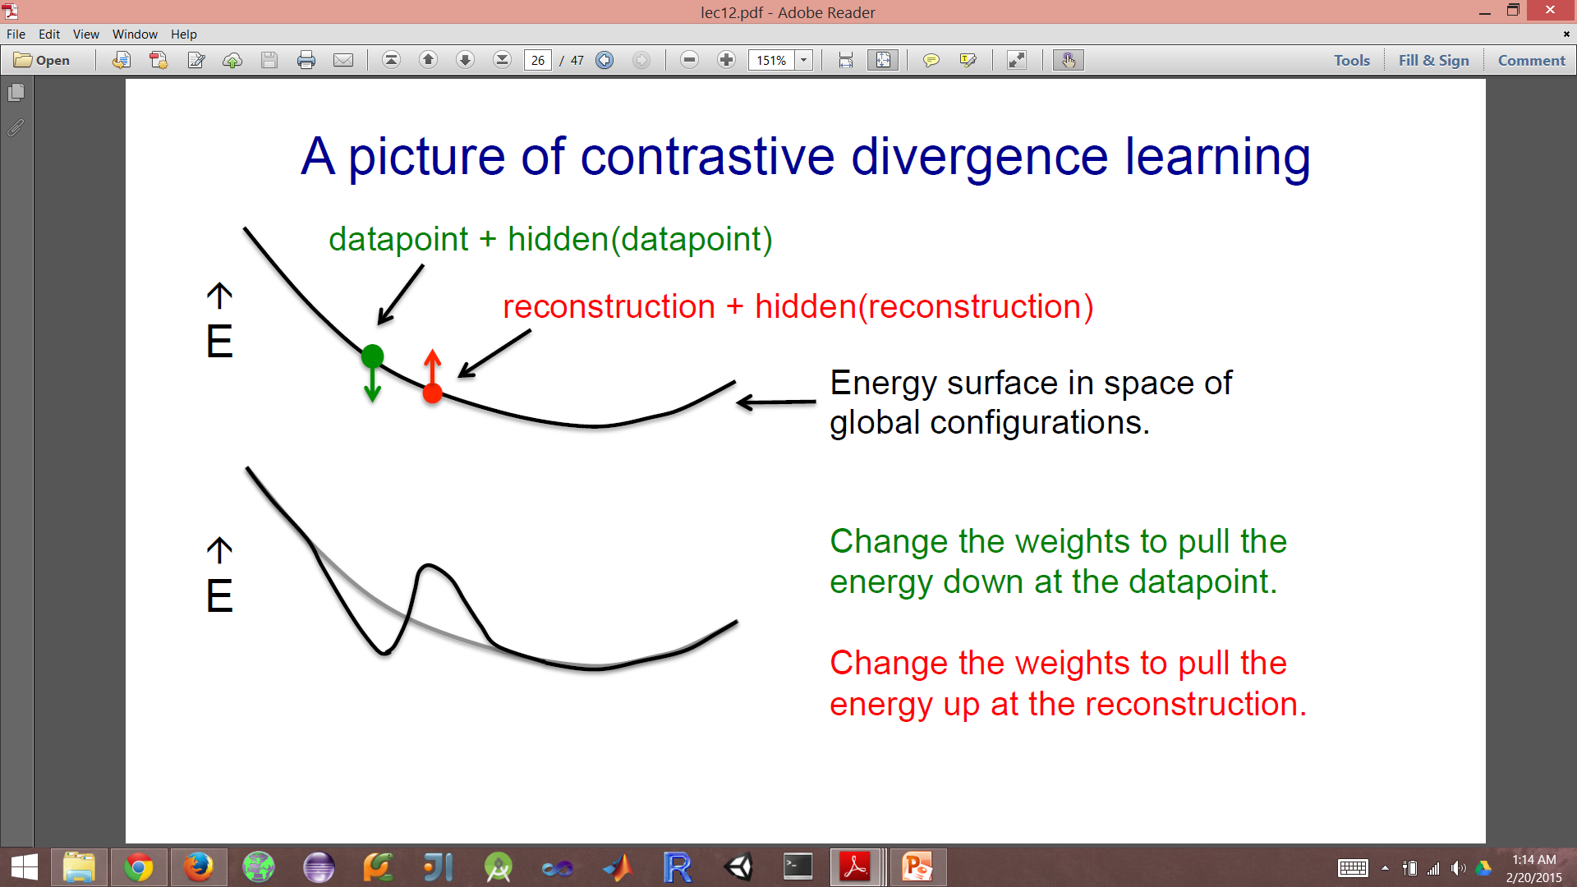
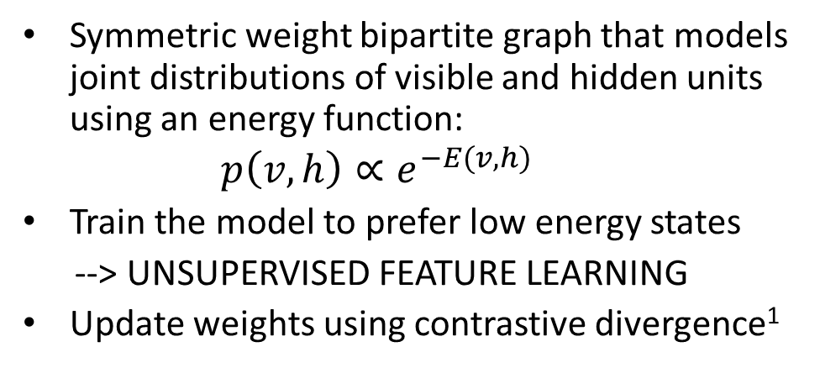
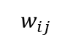
Some Background on RBMS
Symmetric weight bipartite graph that models joint distributions of visible and hidden units using an energy function:
$$p\left(v,h\right)∝e^{−E(v,h)}$$
Train the model to prefer low energy states
--> UNSUPERVISED FEATURE LEARNING
Update weights using contrastive divergence¹
Visible units
i
$$w_{ij}$$
j
Hidden units
1. Formula and figures taken from Geoffrey Hinton’s Neural Networks for Machine Learning on Coursera. Accessed 2/17/2015.

Slide 3
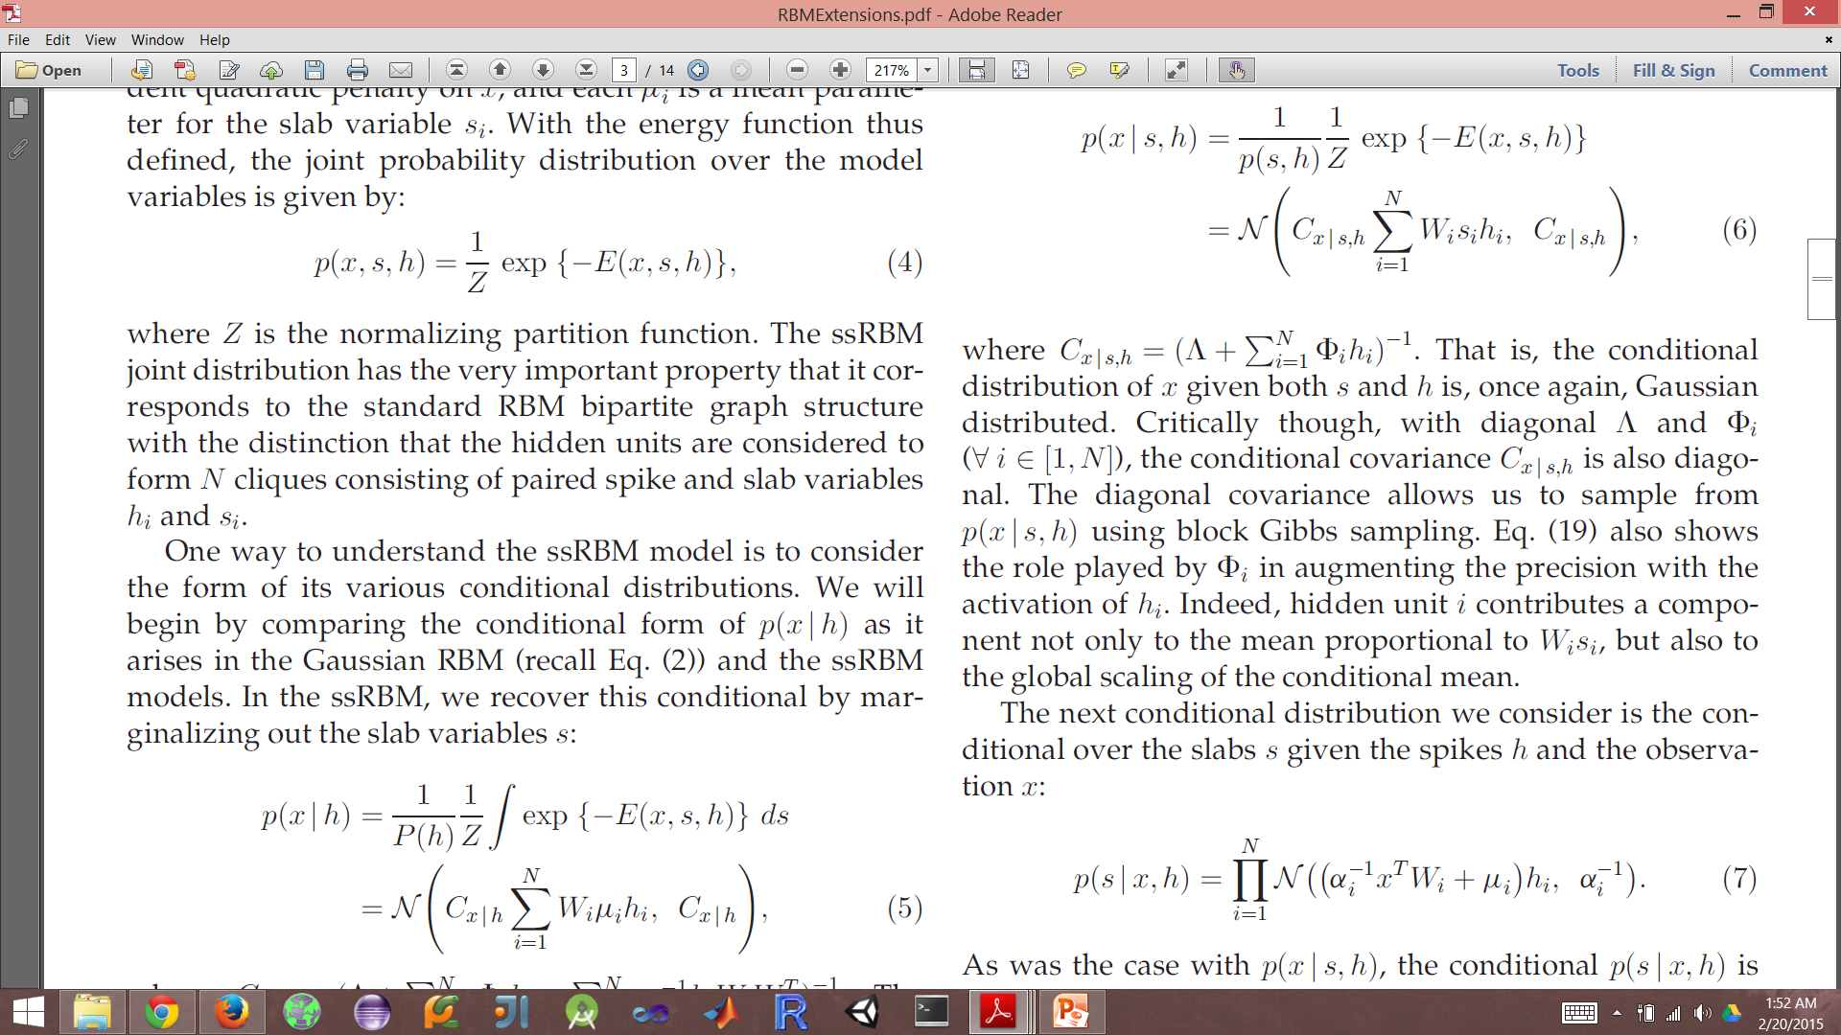
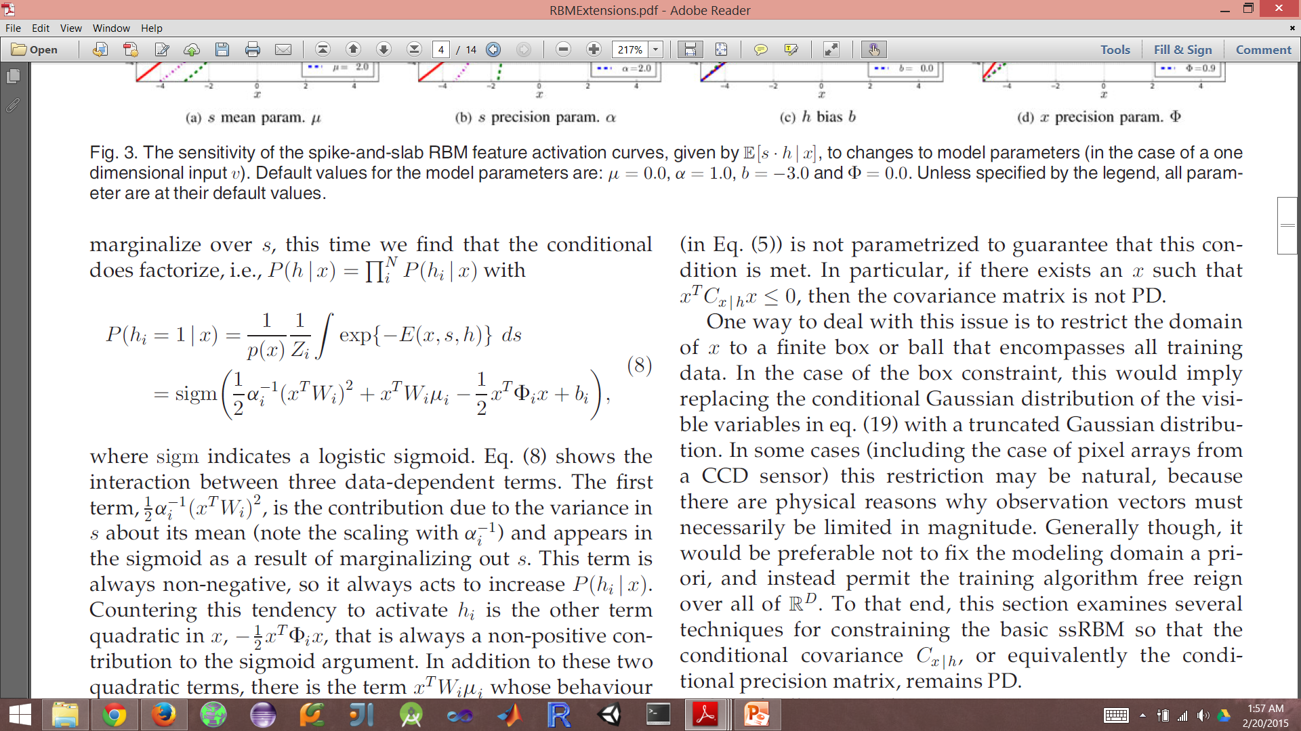
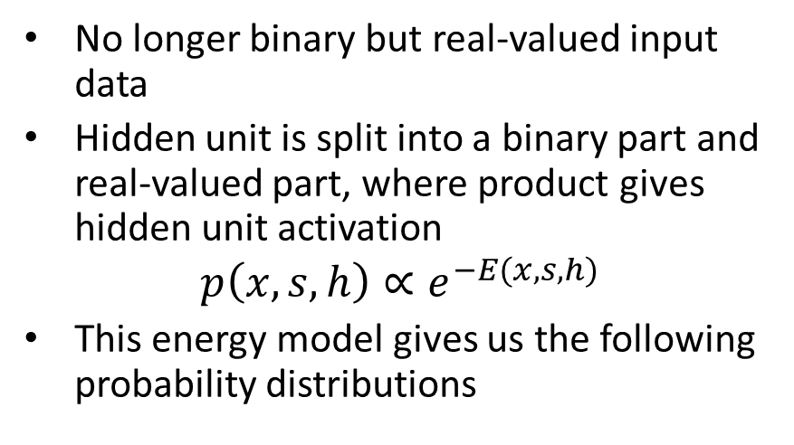
Spike and Slab RBM
Sub-components
No longer binary but real-valued input data
Hidden unit is split into a binary part and real-valued part, where product gives hidden unit activation
$$p\left(x,s,h\right)∝e^{−E(x,s,h)}$$
This energy model gives us the following probability distributions
h: binary spike
s: real-valued slab
Hidden units
Gaussian
Visible units

Slide 4
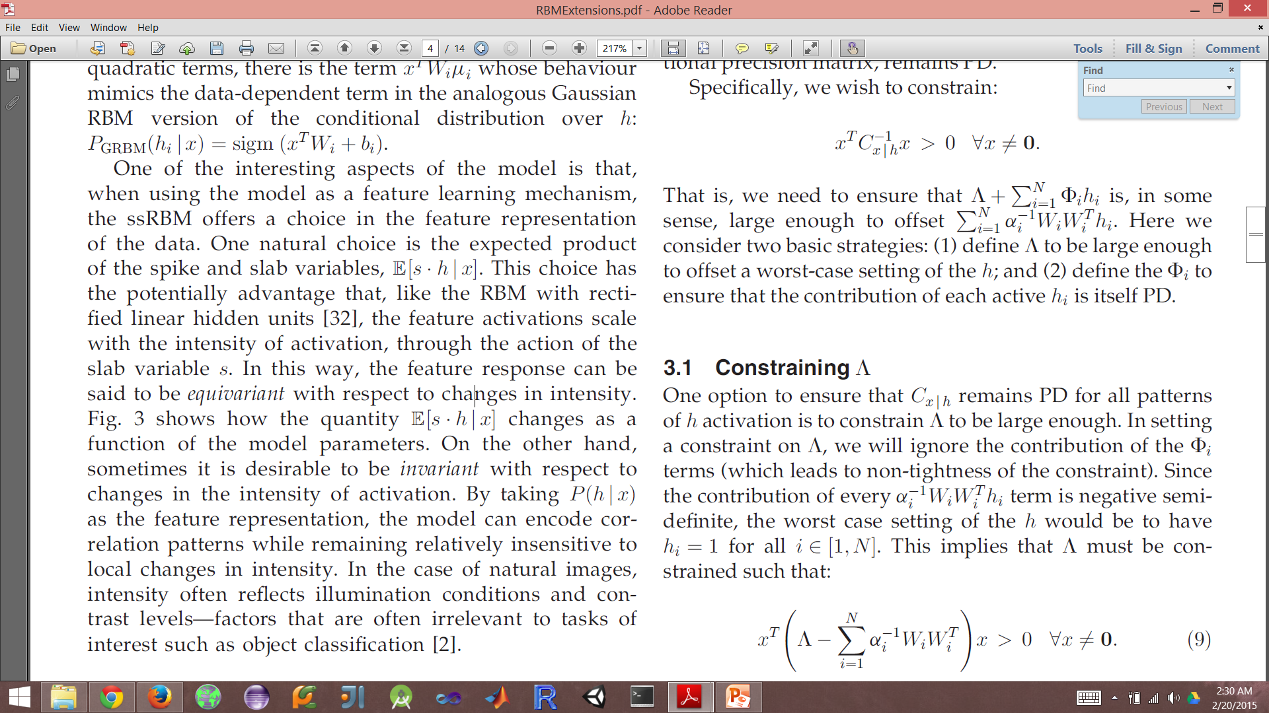
Learning
Traditional RBMs learn by Gibbs sampling from p(h|v) and p(v|h), which can be done in parallel over nodes due to conditional independence
ssRBM can’t sample easily from p(x|h) as it has non-diagonal covariance (i.e. no conditional independence)
Solution is to sample slab distribution p(s|h,x) first then sample from p(x|s,h) for efficient approximation of p(x,s,h)
With this can use contrastive divergence as before
Extracted features:
Slab variable scales the intensity of the activation
Invariant to intensity – good for ignoring changing illumination and contrast levels in natural images

Slide 5
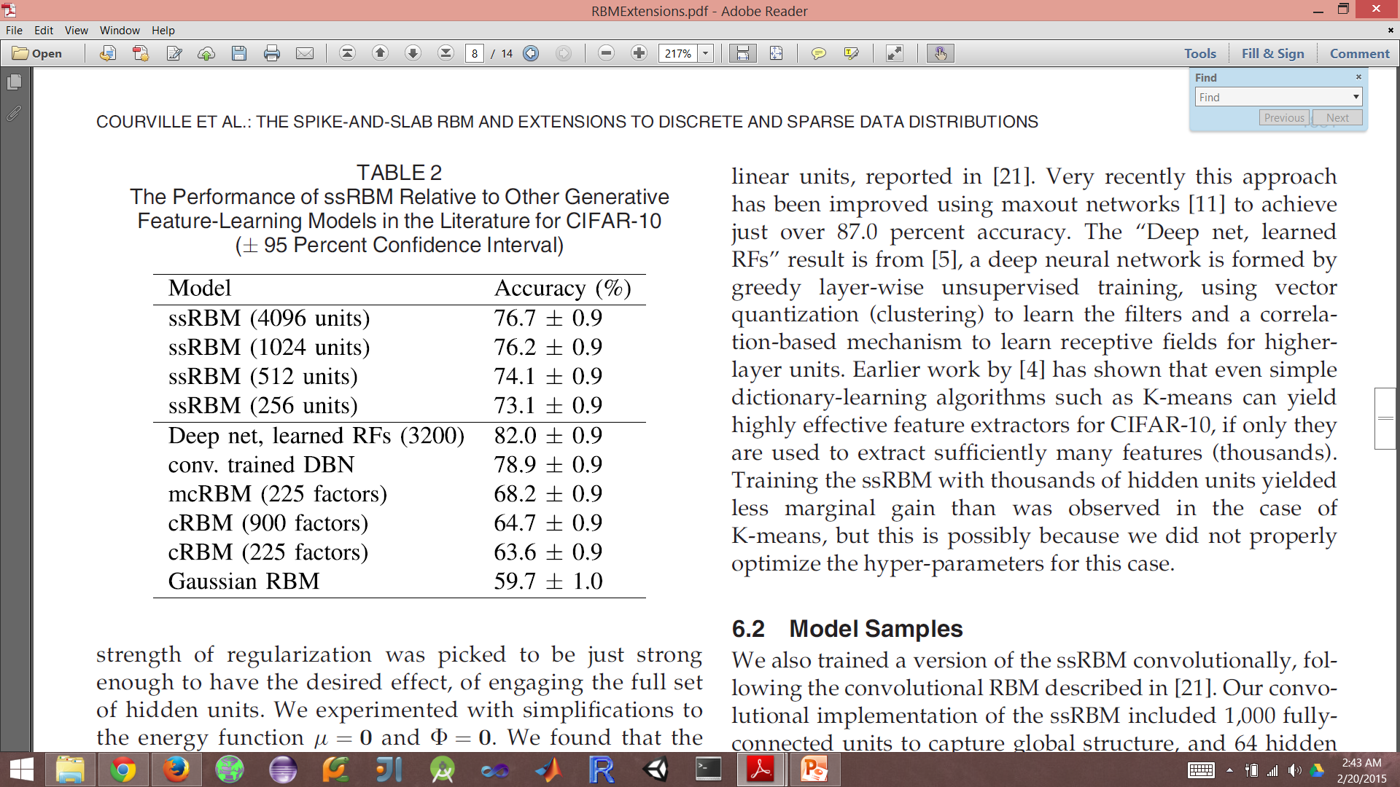
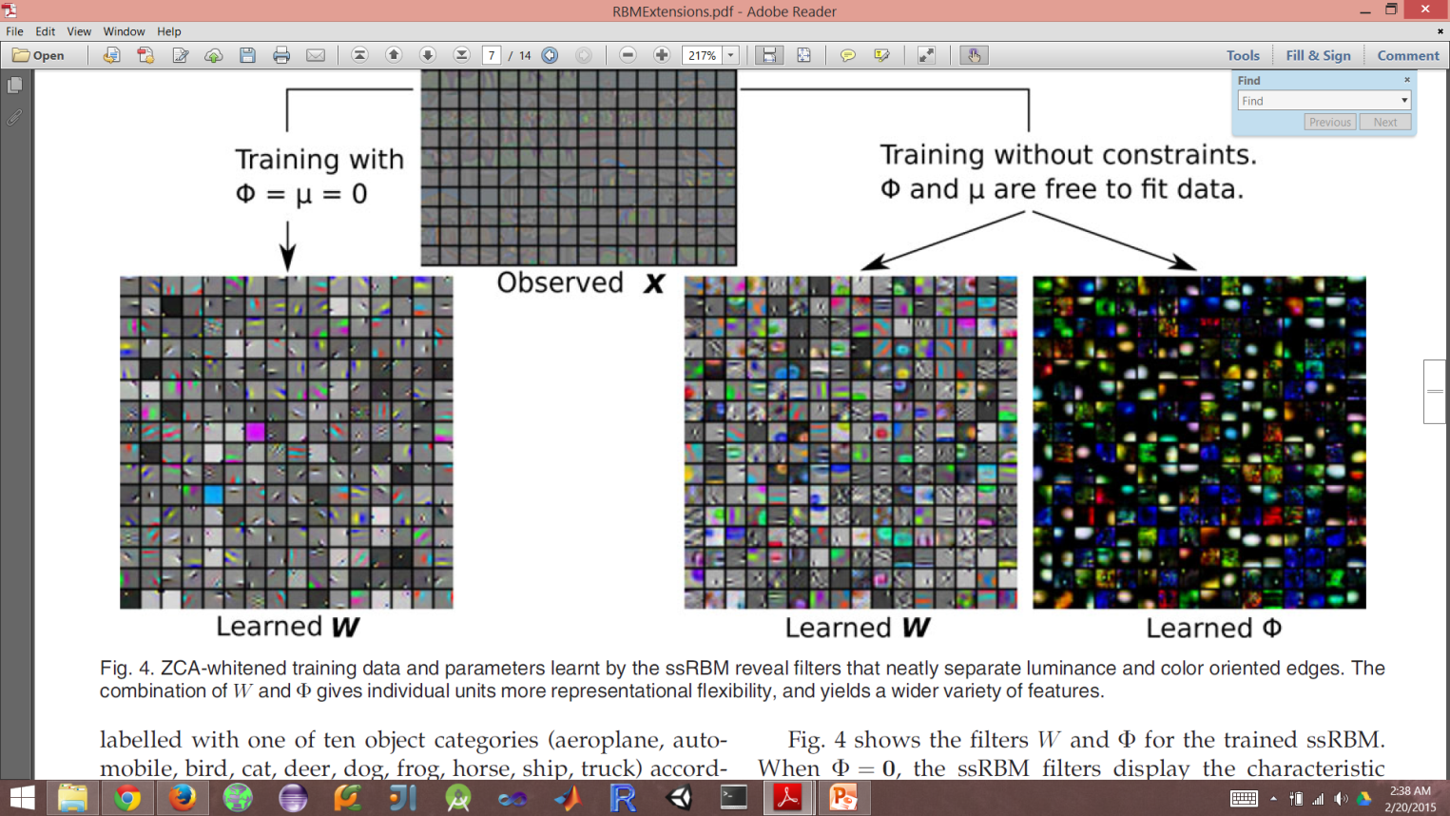
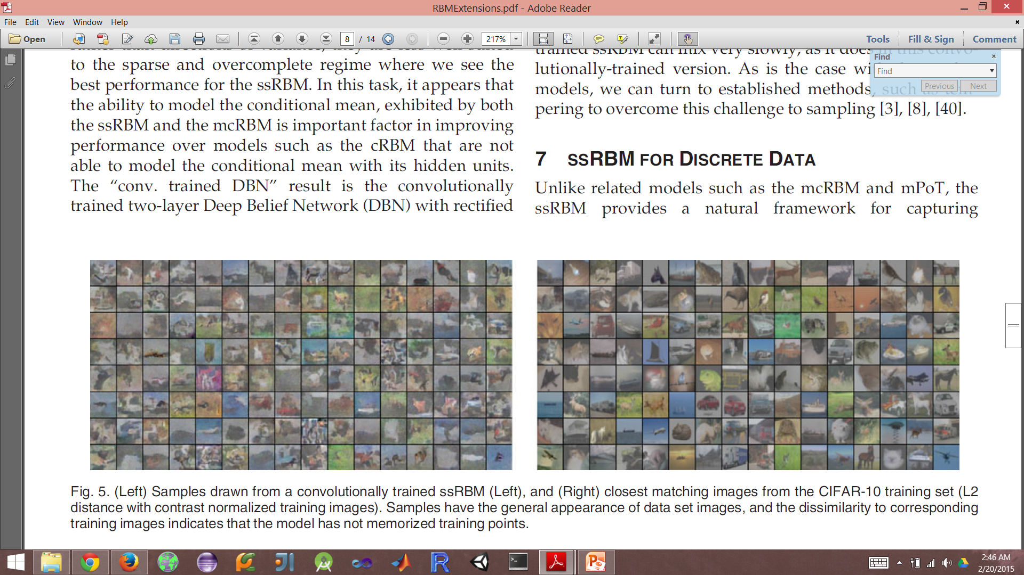
Results
Used ssRBM as feature extraction on images from ten object categories followed by a SVM for classification
Visualization of learned weights as feature filters
Samples on right drawn from the model have appearance of the dataset but are not images that actually exist in the dataset, hence why this is called a generative model

